Slide 1
Machine Learning
Unit-1

Slide 2
Examples of Machine Learning Problems-
Here are some common examples of machine learning problems across various domains:
Classification:
Email Spam Detection: Classifying emails as spam or not spam.
Image Recognition: Identifying objects, animals, or people in images.
Sentiment Analysis: Determining whether a piece of text (like a review) is positive, negative, or neutral.
Regression:
House Price Prediction: Estimating the price of a house based on features like location, size, and number of bedrooms.
Stock Price Prediction: Forecasting future stock prices based on historical data.
Sales Forecasting: Predicting future sales volumes based on past sales data.

Slide 3
Examples of Machine Learning Problems-
3. Clustering:
Customer Segmentation: Grouping customers into segments based on purchasing behavior.
Image Segmentation: Dividing an image into segments to simplify its analysis.
Anomaly Detection: Identifying unusual data points in a dataset, such as fraud detection in banking.
4. Reinforcement Learning:
Game Playing: Developing algorithms to play games like chess or Go.
Robotics: Training robots to perform tasks, such as navigating environments or assembling products.
5. Natural Language Processing (NLP):
Machine Translation: Translating text from one language to another.
Speech Recognition: Converting spoken language into text.
Text Summarization: Creating a summary of a long document or article.

Slide 4
Examples of Machine Learning Problems-
6. Recommendation Systems:
Movie Recommendations: Suggesting movies to users based on their past viewing habits.
Product Recommendations: Recommending products to customers based on their purchase history or browsing behavior.
7. Dimensionality Reduction:
Feature Reduction: Reducing the number of variables in a dataset to improve model performance and visualization.
Data Compression: Reducing the size of data while maintaining its essential features.

Slide 5
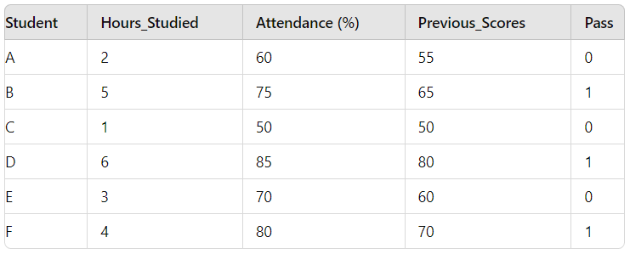
Structure of Machine Learning-
Let's create a simple, real-time example using a dummy dataset to predict whether a student will pass or fail based on some features. We'll go through the steps using a small dataset and see how a machine learning model can be used to make predictions.
Here’s a simple dataset:-
Hours_Studied: Number of hours the student studied.
Attendance: Percentage of classes attended.
Previous_Scores: Average of previous exam scores.
Pass: Whether the student passed (1 for pass, 0 for fail).
Step 1:-
Data Collection:- We have collected a dataset with
information about students.

Slide 6
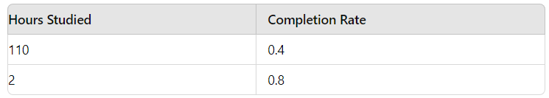
Structure of Machine Learning-
Step 2:-
Data Preparation:-
Cleaning: Ensure there are no missing values or values which are incorrect, eg; negative values. Here, our dataset is already clean, so we don’t need to clean the data.
Transformation: We might scale the features so they are all on a similar scale, but since they are in similar ranges, it might not be necessary for this simple example.
But, for example;
Suppose, we have a dataset like this:-

Slide 7
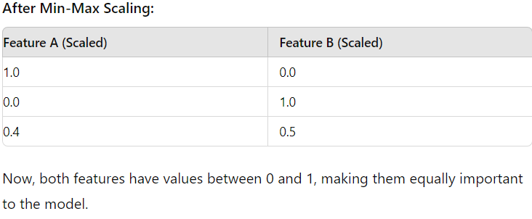
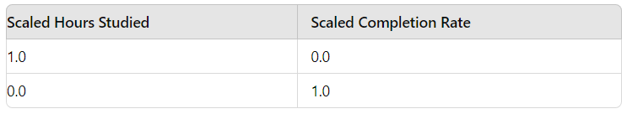
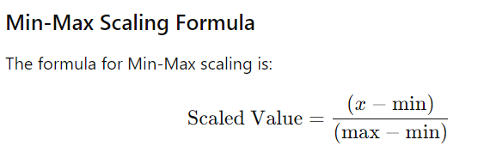
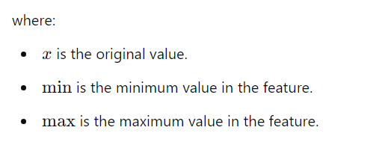
Structure of Machine Learning-
Now, lets see how we converted the original values to scaled values (between 0 and 1).

Slide 8
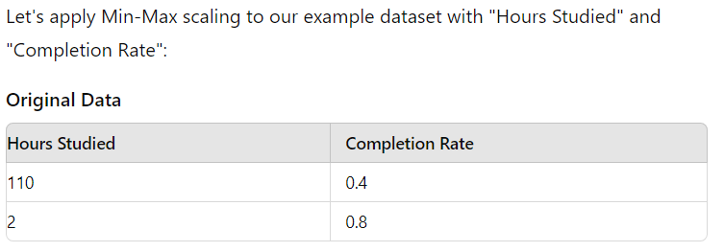
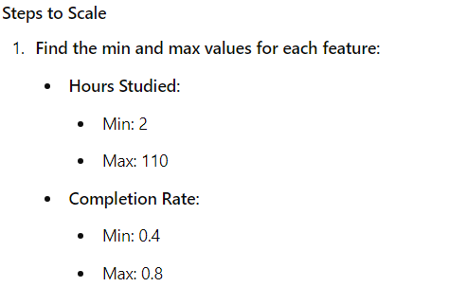
Structure of Machine Learning-

Slide 9
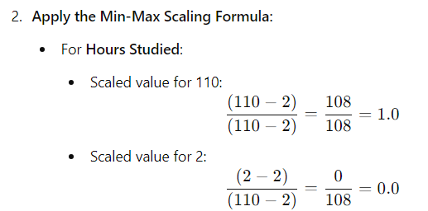
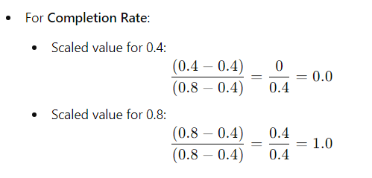
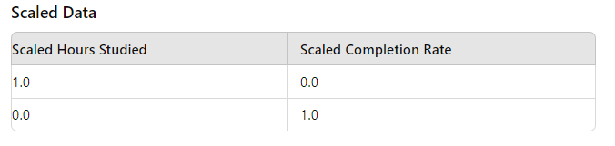

Structure of Machine Learning-

Slide 10
Structure of Machine Learning-
Splitting: We divide the data into training and test sets. Let's say we use 4 entries for training and 2 for testing:
Training Set: A, B, D, F
Test Set: C, E
Step 3:-
Model Selection:- We'll use Logistic Regression, which is a common choice for binary classification tasks (like predicting pass/fail).
Step 4:-
Model Training:- The model learns from the training data to find the relationship between the features (Hours_Studied, Attendance, Previous_Scores) and the label (Pass) and gets trained by using logistic regression.

Slide 11
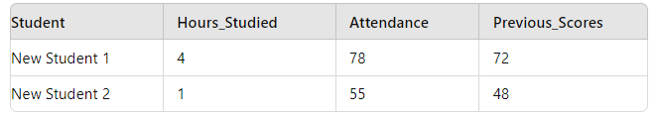
Structure of Machine Learning-
Step 5:-
Evaluation:- We test the model using the test data (Students C and E) to see how well it predicts the pass/fail outcome.
Step 6:-
Prediction:- Let’s make predictions for new students:-

Slide 12
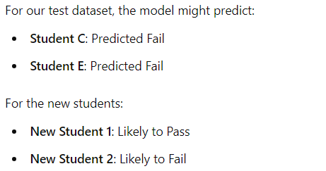
Structure of Machine Learning-
Result:-
We give it new data it hasn’t seen before and if it predicts correctly whether the student passed or failed, that means the project is successful.

Slide 13
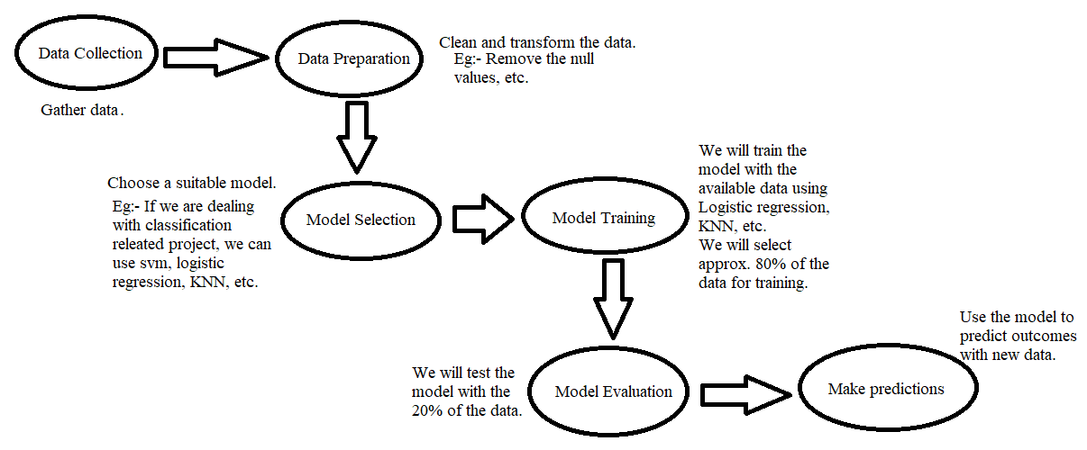
Structure of Machine Learning-

Slide 14
Learning versus Designing-
Designing a learning system to teach a machine involves several steps:-
1. Define the Problem:
What’s the goal? Figure out what you want the machine to learn or solve.
Inputs and Outputs: Decide what information you’ll give the machine and what you want it to give back.
2. Collect and Preprocess Data:
Gather Data: Collect the information you’ll use to train the machine.
Clean and Prepare: Fix any errors in the data eg: removing nulls, etc, change it into a useful format, and adjust the data to be consistent.
3. Choose an algorithm:
Pick a Method: Choose a method or technique for the machine to learn from the data (like supervised or unsupervised learning).
Tuning: Adjust settings to help the machine learn better.
4. Train the model:
Teach the Machine: Select 80% of the data for training, then train the model on the training data (chosen 80% of the data) this involves running the algorithm on the training data.
Adjust: Make changes to the machine based on how well it’s learning from the feedback.

Slide 15
Learning versus Designing-
5. Test the model:
Check Performance: Test to evaluate its performance.
Identify Problems: Identify any issues or limitations with the model and suggest area for improvement.
6. Deploy the model:
Put into Use: Deploy in a production environment.
Integration: Involve integrating the model into an existing system or developing a new application that utilizes the model.

Slide 16
Learning versus Designing-
Let’s see an example:-
1. Define the Problem:
Goal: Predict the price of a house.
Inputs: Number of bedrooms in the house.
Desired Output: The price of the house.
2. Collect and Preprocess Data:
Collect Data: Gather a dataset that includes the number of bedrooms and the corresponding house prices.
Clean Data: Remove any errors or missing values. For example, if some houses have missing prices or bedroom numbers, you need to handle those.
Transform Data: Ensure the data is in a format suitable for analysis. For instance, you might need to convert bedroom numbers into numerical values if they are not already.

Slide 17
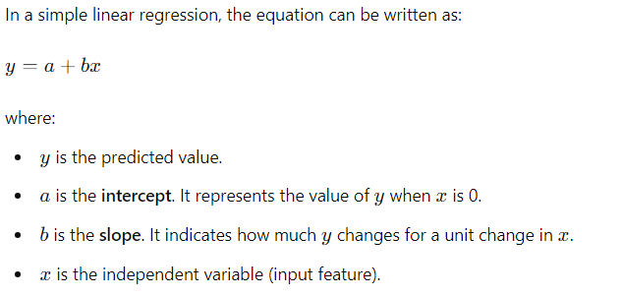
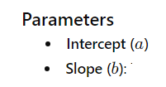
Learning versus Designing-
3. Choose an Algorithm:
Pick a Method: For this problem, a simple linear regression might work well. This algorithm tries to find the best line that predicts house prices based on the number of bedrooms.
Tuning: Adjust parameters of the linear regression model, such as learning rate, to improve performance.
Eg:- Before adjusting parameters (a) and (b), it was 80% accurate, after adjusting by using optimization techniques like gradient descent or least squares, its 90% accurate

Slide 18
Learning versus Designing-
4. Train the Model:
Teach the Machine: Use your data (number of bedrooms and house prices) to train the model. The model will learn the relationship between the number of bedrooms and the house price.
Adjust: Based on how well the model is performing (using your evaluation metric), make any necessary adjustments.
5. Test the Model:
Check Performance: Use a separate set of data (not used in training) to see how well the model predicts house prices for new houses.
Identify Problems: If the model’s predictions are far off from actual prices, look into why this might be happening and consider improving your model.
6. Deploy the Model:
Put into Use: Make the model available for use, perhaps through a web application where users can input the number of bedrooms and get a price estimate.
Integration: If you have a real estate website, you could integrate the model so that it can provide price predictions directly on the site.

Slide 19
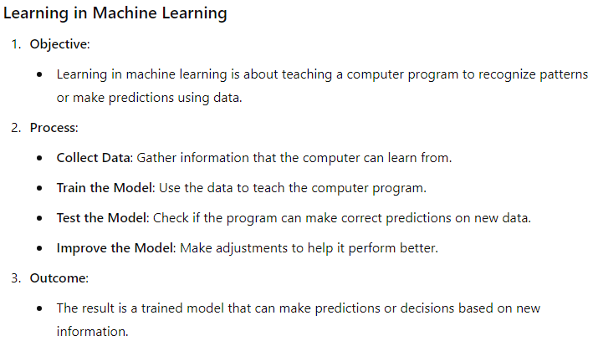
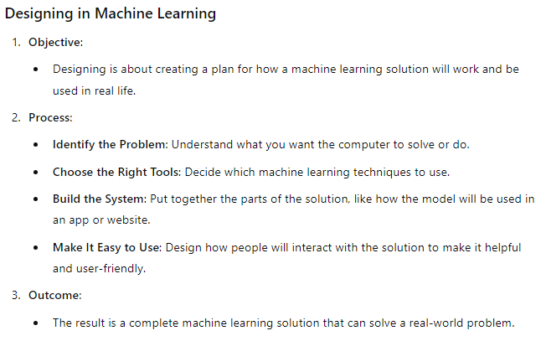
Learning versus Designing-
How Learning differs with the designing:- Learning is about teaching the computer using data, whereas Designing is about planning how to use what the computer has learned to solve problems or create useful tools.

Slide 20
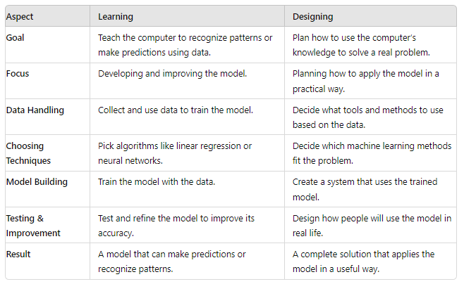
Learning versus Designing-

Slide 21
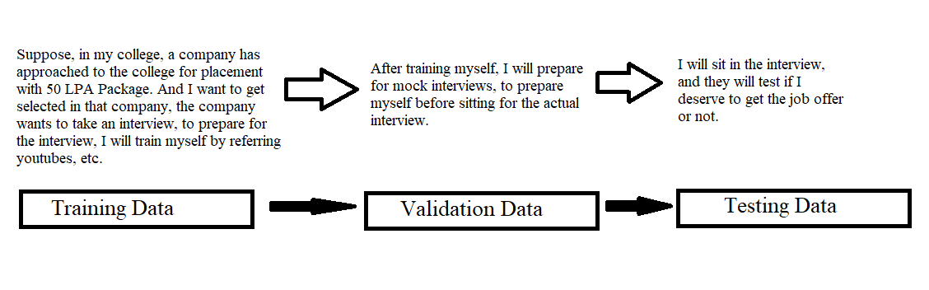
Training versus Testing-

Slide 22
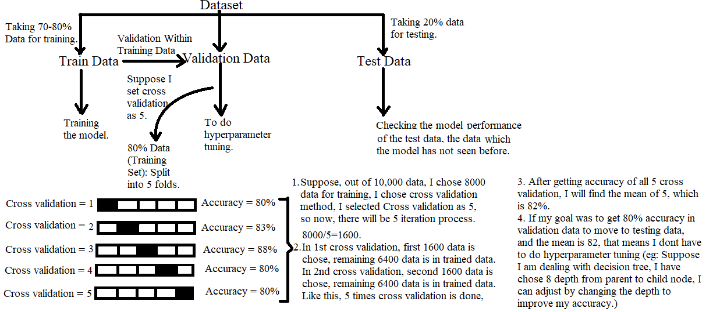
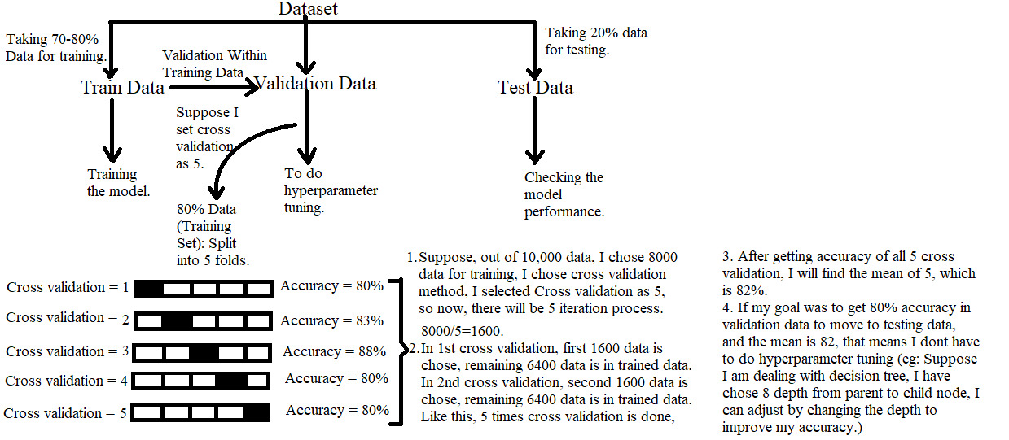
Training versus Testing-

Slide 23
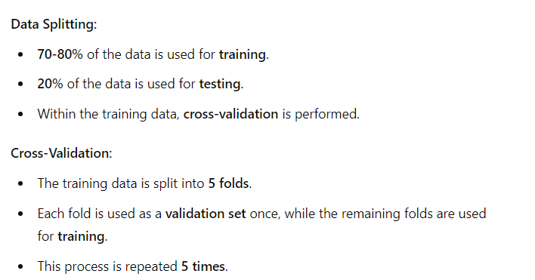
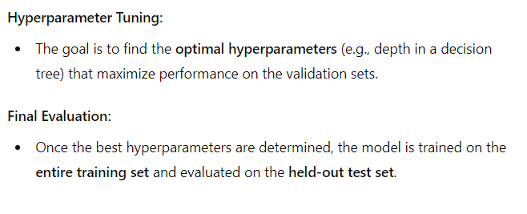
Training versus Testing-

Slide 24
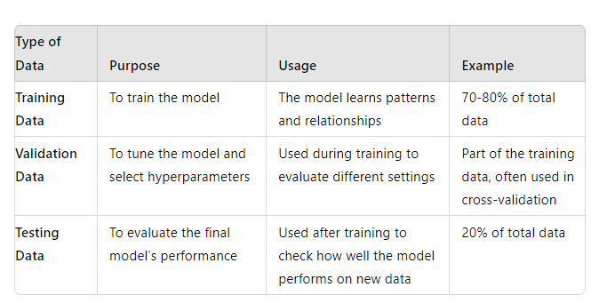
Training versus Testing-

Slide 25
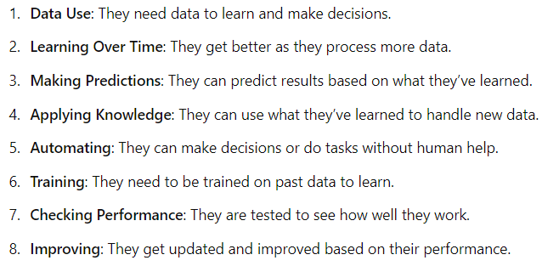
Characteristics of machine learning tasks:-

Slide 26
Predictive and Descriptive Tasks in ML
Predictive tasks:-
Predictive tasks in machine learning involve using models to make predictions based on input data. It aim to say something about future results not of current behaviour.
Regression: Predicting a continuous value (e.g., predicting house prices based on features like size and location).
Classification: Predicting a category or class label (e.g., determining if an email is spam or not).
Time Series Forecasting: Predicting future values based on past data (e.g., forecasting stock prices or weather conditions).
These tasks use historical data to train models, which then make predictions on new, unseen data.

Slide 27
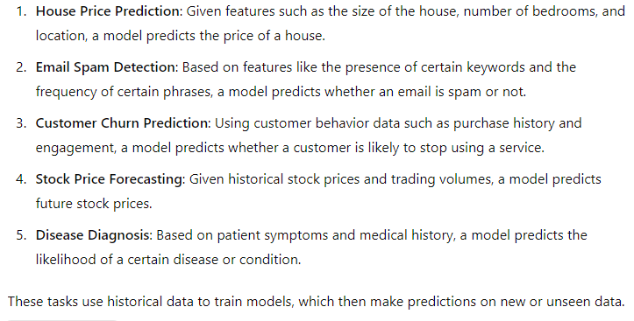
Predictive and Descriptive Tasks in ML
Here are some examples of predictive tasks in machine learning:

Slide 28
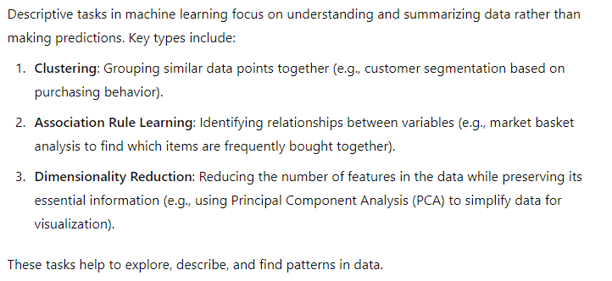
Predictive and Descriptive Tasks in ML
Descriptive tasks:-

Slide 29
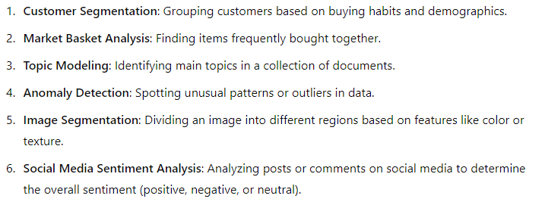
Predictive and Descriptive Tasks in ML-
Here are some examples of descriptive tasks in machine learning:

Slide 30
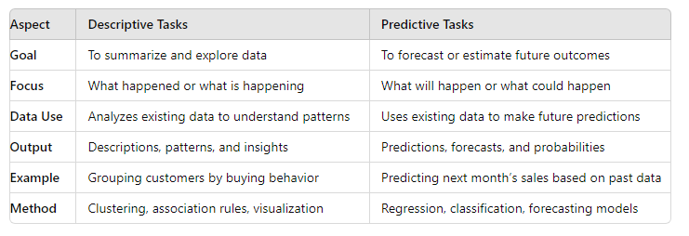
Predictive and Descriptive Tasks in ML

Slide 31
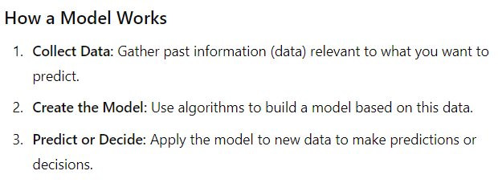
Model

Slide 32
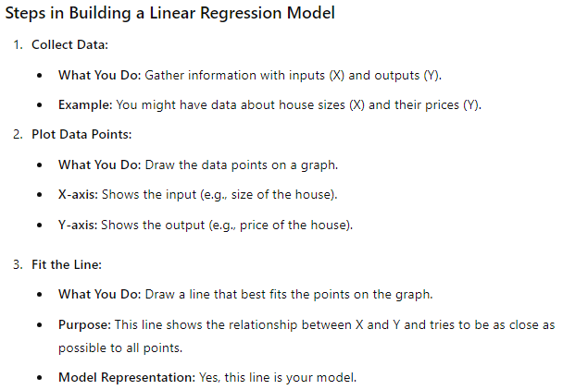
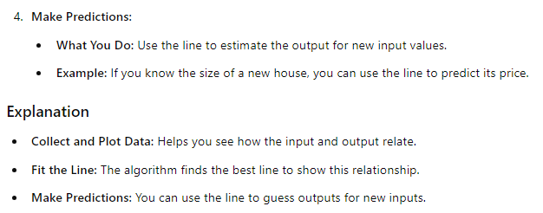
Model
Suppose you're predicting house prices (Y-axis) based on the size of the house (X-axis). Once you have the regression line, you can input a house size, and the model will give you a predicted price based on the line.

Slide 33
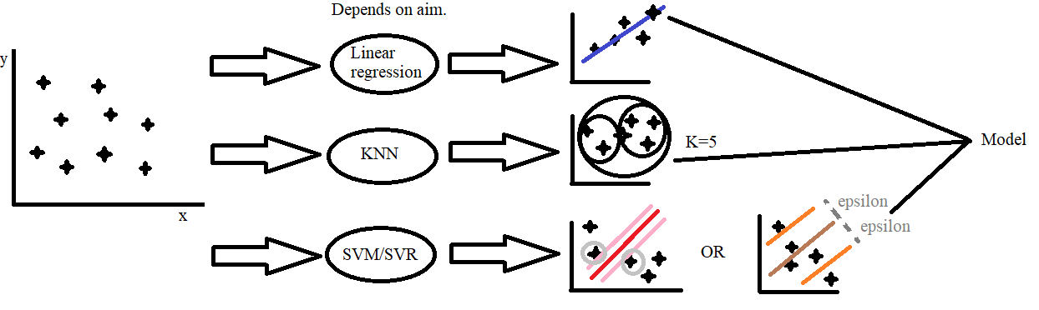
Model
When a new data point is introduced, each model uses the learned parameters or characteristics to predict the outcome:Linear Regression will use the coefficients of the line to predict a continuous output based on the input value.
KNN will look at the 'K' nearest points to the new data point to determine its output. In K-Nearest Neighbors (KNN), the output for a new data point is determined based on the "votes" of its K nearest neighbors.
SVM/SVR will classify the new point or predict a value based on which side of the hyperplane the point lies on or how it relates to the margin.

Slide 34
There are different types of Machine Learning Models:-
Geometric Models
Logical Models
Probabilistic Models

Slide 35
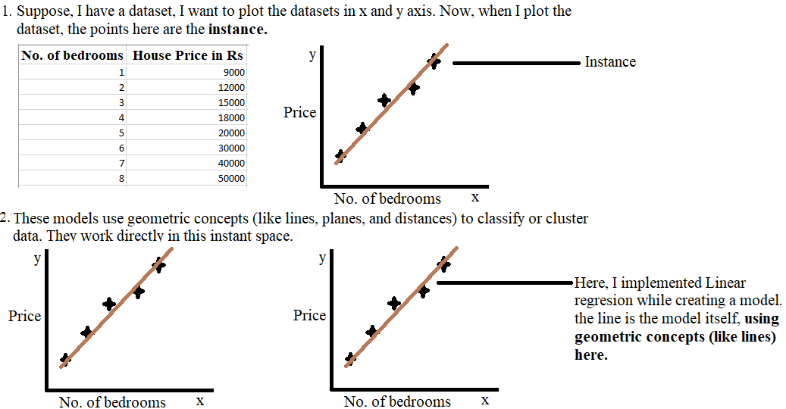
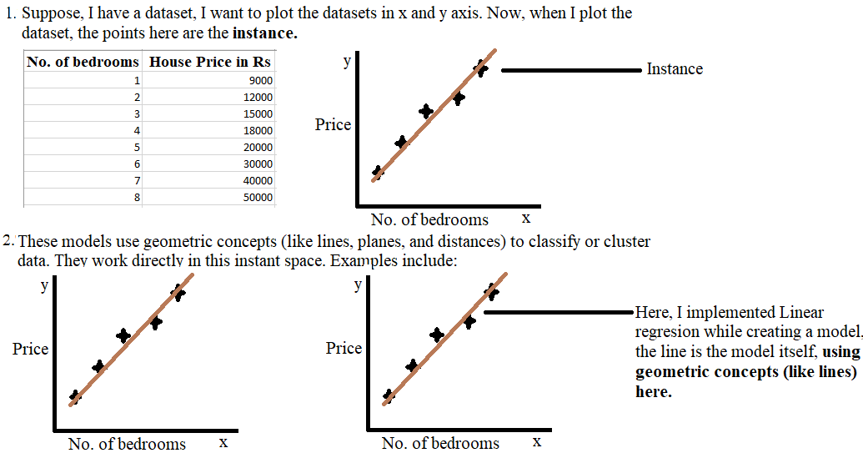
Geometric Models:-

Slide 36
Geometric Models:-
Geometrical models in machine learning utilize geometric concepts to address problems like classification, regression, and clustering. A geometric model is constructed directly in instant space using geometric concepts such as lines, planes, and distance. One main advantage of geometric classifiers is that they are easy to visualize as long as we keep to 2 to 3 dimensions.
Instant Space: This is the space where your data points (dots) are plotted. It represents all possible values, whether they are in your dataset or not.
Geometric Models: These models use geometric concepts (like lines, planes, and distances) to classify or cluster data. They work directly in this instant space. Examples include:
Linear Classifiers: These use lines or hyperplanes to separate different classes.
Support Vector Machines (SVM): These find the optimal hyperplane that separates classes with the maximum margin.
K-Nearest Neighbors (KNN): This classifies a point based on the majority class among its nearest neighbors.
K-Means Clustering: This groups data into clusters based on distance to cluster centers.

Slide 37
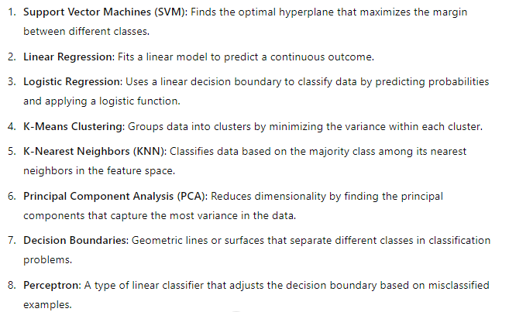
Key types of geometric models:-

Slide 38
Logical Models:-
Logical models in machine learning use logical rules to make decisions and represent about data. They focus on using logical reasoning to derive conclusions from input features. One of the most well-known logical models in machine learning is the decision tree. Decision trees are a popular classification algorithm that uses a tree-like model of decisions and their possible consequences to classify data points.
Types of Logical Models:-
Rule-Based Models: Use sets of rules to make decisions, like using if-else. For instance, expert systems rely heavily on predefined rules to draw conclusions.
Decision Trees: A type of model that uses a tree-like structure to represent decisions and their possible consequences. Each node represents a decision point, and branches represent the outcomes of those decisions.
Boolean Models: Use Boolean algebra to represent logical expressions, where variables can take on values of true or false.

Slide 39
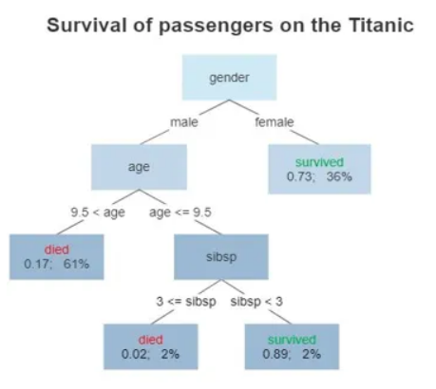
Examples of Logical Models:-
Decision Trees-
A tree showing survival of passengers on the Titanic(“sibsp” is the number of spouses or siblings aboard). The figures under the leaves show the probability of survival and the percentage of observations in the leaf. Summarizing: Your chances of survival were good if you were (i) a female or (ii) a male younger than 9.5 years with strictly less than 3 siblings.

Slide 40
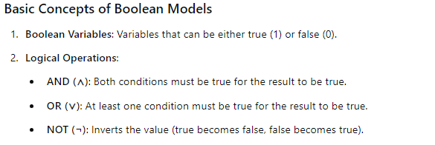
Examples of Logical Models:-
Boolean Models-

Slide 41
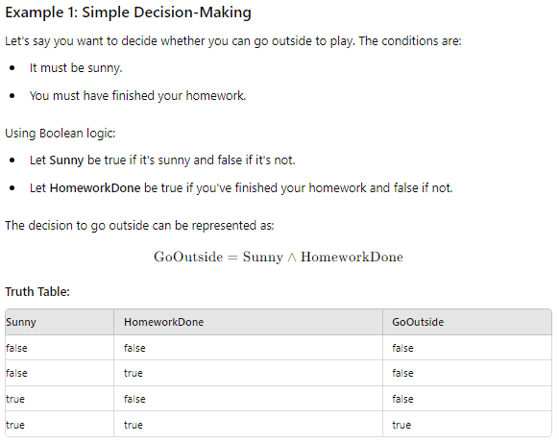
Examples of Logical Models:-
Boolean Models-

Slide 42
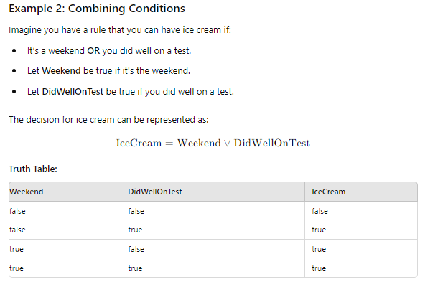
Examples of Logical Models:-
Boolean Models-

Slide 43
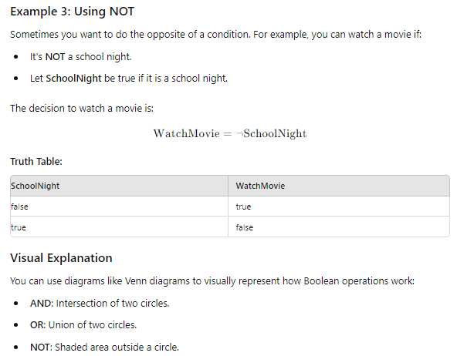
Examples of Logical Models:-
Boolean Models-

Slide 44
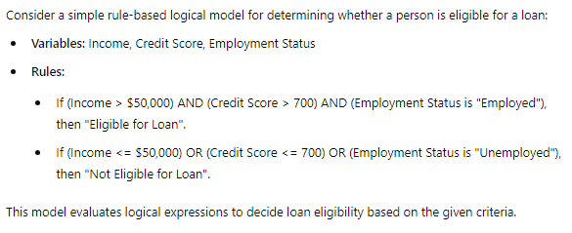
Examples of Logical Models:-
Rule-Based Models-

Slide 45
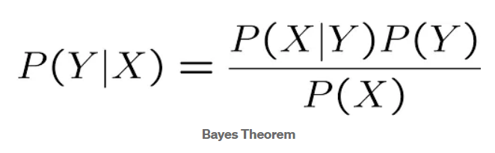
Probabilistic Models:-
A probabilistic model is like a tool that helps us understand and predict things when we're not sure what will happen. It uses the idea of probability, which is all about how likely something is to happen.
For Example:-
When you calculate probabilities using a probabilistic model, like with Bayes' theorem, you can use those probabilities to make decisions. For example:
If you have a probability of 0.48 that it will rain tomorrow, you might decide not to carry an umbrella because it's less likely to rain.
If the probability is 0.50 or higher, you might choose to carry an umbrella because there's a significant chance of rain.

Slide 46
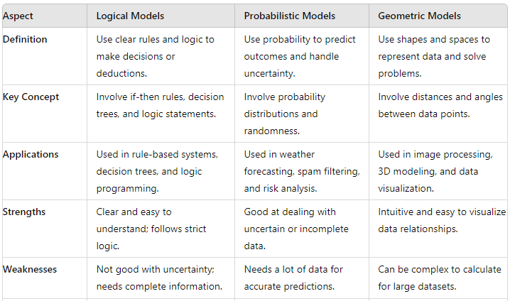
Geometric Models VS Logical Models VS Probabilistic Models-

Slide 47
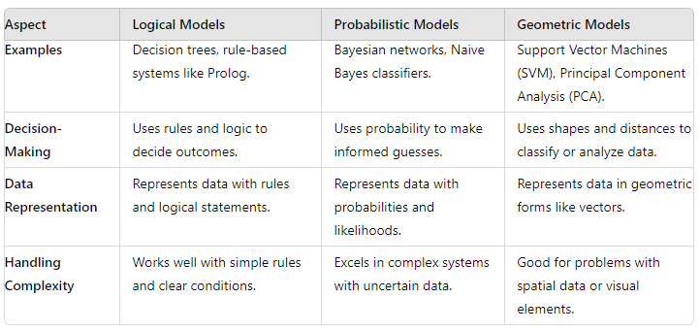
Geometric Models VS Logical Models VS Probabilistic Models-

Slide 48
Feature Types:-
In machine learning, features are the pieces of information we use to make predictions. Here are the main types of features:
Numeric Features: Numbers that you can measure.
Continuous: These can be any number, like height or temperature.
Discrete: These are specific numbers, like the number of cars you own.
Categorical Features: Groups or categories.
Nominal: Categories without order, like colors (red, green, blue). Eg: Types of pets like cats, dogs, or birds. You can't say one is "better" or "worse" than the other; they are just different.
Ordinal: Categories with order, like rankings (first, second, third). Eg: Ranks like first place, second place, and third place. You can say first is better than second, and second is better than third.
Binary Features: Two possible values, like yes/no or true/false.
Text Features: Words or sentences that can be converted into numbers for analysis.
Time Series Features: Data collected over time, like daily temperatures or stock prices.
Image Features: Information from images, like pixel colors and shapes.
Geospatial Features: Information about locations, like latitude and longitude.

Slide 49
Feature Construction:-
Feature construction involves creating new features (or variables) from existing data to improve the performance of a model.
For example in COVID-19 dataset:-
Confirmed Cases: Total number of confirmed COVID-19 cases.
Recovered Cases: Total number of cases that have recovered.
Death Cases: Total number of death cases.
Active Cases: Calculate this as Active Cases = Confirmed Cases – (Recovered Cases – Deaths).
Creating the "Active Cases" feature from the existing “Confirmed Cases”, “Recovered Cases”, and “Deaths Cases”) is a classic example of feature construction. This process helps provide more meaningful data to machine learning models, potentially improving their predictive performance.

Slide 50
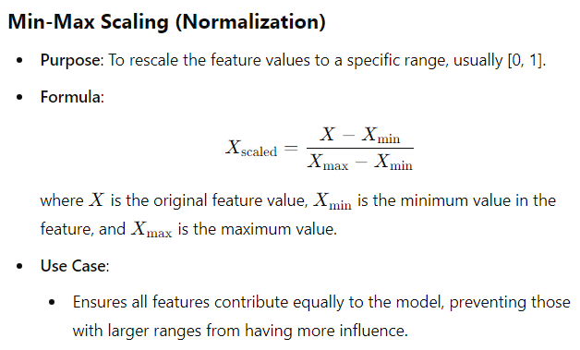
Feature Transformation:-
Normalization and standardization are commonly used techniques for feature transformation before applying machine learning algorithms. They help to bring features onto a similar scale, which can improve the performance and convergence speed of many machine learning models.

Slide 51
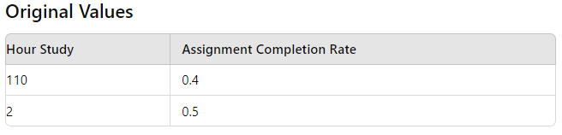
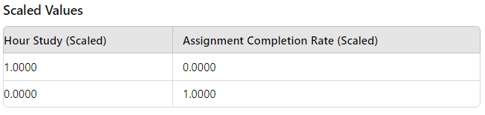
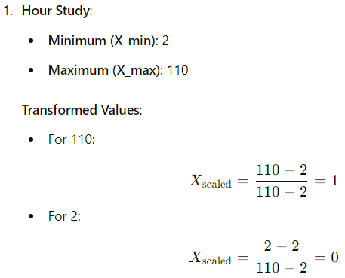

Feature Transformation:-

Slide 52

Feature Transformation:-

Slide 53

Feature Transformation:-

Slide 54


Feature Transformation:-

Slide 55



Feature Transformation:-

Slide 56

Feature Transformation:-
Now, if we will find the mean and standard deviation of both exams, the mean of the standardized scores for both exams is 0, and the standard deviation is 1.

Slide 57

Feature Transformation:-
Why Convert to Standardized Format:-

Slide 58


Feature Transformation:-
Lets plot the original data as well as Standardized Data:-

Slide 59


Feature Transformation:-
Difference between Normalization and Standardization:-

Slide 60

Feature Transformation:-
When to use Standardization?

Slide 61



Feature Transformation:-
The standardized values show that most data points are clustered around a mean of 0, and the outlier is far from the mean but doesn't distort the scale of the other values as drastically as in normalization.

Slide 62
Feature Transformation:-
Generally, Normalization and standardization are common methods for feature scaling, but there are other techniques as well. Some of them include:
Function Transformers:- A Function Transformer is a way to change the data to make it easier for machine learning models to understand. Imagine you have a set of numbers, but they are all really big or really small, which can make it hard for a model to work with them. A Function Transformer applies a mathematical function to your data to adjust it.
Log Transform: This helps if your data has very large numbers. It turns big numbers into smaller numbers, making them easier to work with.
Original Data: 1, 1000, 2000
Log Transform (natural log):
log(1) ≈ 0
log(1000) ≈ 6.91
log(2000) ≈ 7.60
After the log transform, the values are scaled down, making them easier to work with for many machine learning models.

Slide 63
Feature Transformation:-
2. Square Transform: This changes each number by squaring it. If you have small numbers, squaring them makes them bigger.
Original values: 2, 4, 100, 1000
Squared values: 4, 16, 10,000, 1,000,000
By comparing the squared values to the original ones, you can see:
Increased Differences: The difference between the squared values becomes much larger compared to the differences in the original values. For example, the difference between 1000 and 100 is 900, but the difference between 1,000,000 and 10,000 is 990,000.
Patterns: Patterns or relationships in the data become more pronounced with the squared values. Large values become even more significant compared to smaller ones.
Decreasing Left Skewness: Left-skewed data (negative skew) is characterized by a longer tail on the left side. By squaring the data, smaller and negative values are disproportionately increased, which can help to balance the distribution and reduce left skewness. This transformation spreads out the smaller values more than the larger values, effectively reducing the impact of the left tail.
Handling Negative Values: Squaring negative numbers results in positive values, which effectively removes negative signs from the data. This is useful in situations where negative values are problematic or need to be transformed for analysis. However, keep in mind that squaring changes the relationships between values and can introduce bias if the negative values carry important information.

Slide 64

Feature Transformation:-
3. Square Root Transform:

Slide 65

Feature Transformation:-
4. Reciprocal Transformation:

Slide 66



Slide 67


Feature Transformation:-
5. Custom Transforms: Based on the domain knowledge of the data, custom transformations can be applied to transform the data into a normal distribution. The custom transforms here can be any function or parameter like sin, cos, tan, cube, etc.
(OR)
Suppose, I am applying a linear transformation to my data:-

Slide 68



Feature Transformation:-
Power Transformers:- Power Transformation techniques are the type of feature transformation technique where the power is applied to the data observations for transforming the data.
Box-Cox Transformation: This method helps to make data more normally distributed. It uses a "power" (denoted by λ) to transform the data.

Slide 69

Feature Transformation:-
2. Yeo-Johnson Transformation:

Slide 70

2. Yeo-Johnson Transformation:
After applying the Yeo-Johnson transform, the transformed values will be more centered around zero and have reduced skewness. It allows you to handle both positive and negative values effectively.

Slide 71

Feature Transformation:-
Quantile Transformers:-

Slide 72


Feature Selection:-
After transforming your features, you select the most relevant ones for your model. This method is known as feature selection.
It is the automatic process of reducing the number of input from the set of features by choosing the relevant variables before feeding them to the machine learning model. The motive is to reduce the irrelevant data(noise) and choose relevant features. It is obvious that giving noise data to the model will not serve a good purpose.

Slide 73


Feature Selection:-
Why Feature Selection:-

Slide 74




Feature Selection:-
Feature selection techniques:-

Slide 75

3. Embedded Methods:
Embedded methods use machine learning models to automatically choose your features. This technique will select the best features during the training itself. Here you train the model and then you see which features are good enough for you.
Embedded methods combine the qualities of filter and wrapper methods.
It’s implemented by algorithms that have their own feature selection methods in them.

Slide 76

Feature Selection:-

Slide 77

Concept of Feature engineering:-

Slide 78

Concept of Feature engineering:-

Slide 79

Concept of Feature engineering:-

Slide 80

Concept of Feature engineering:-

Slide 81

Concept of Feature engineering:-

Slide 82

Concept of Feature engineering:-

